Slide 1
IMPLEMENTATION OF GRAPH EMBEDDING FOR REDUCTION OF MULTIDRUG EFFECTS USING DEEP LEARNING
TEAM MEMBERS: PROJECT GUIDE:
AKASH RAJ R Ms.A.S.HEPSI AJIBAH
FRANKLIN SURYA S

Slide 2
ABSTRACT
Patients often take multiple drugs to manage complex or co-existing diseases, but certain drug combinations can lead to harmful side effects. To address this, we developed an algorithm that predicts drug combinations with minimal side effects using graph embeddings.
While graph analytics provide valuable insights into complex networks, traditional methods are challenged by high computational costs and memory demands due to the high-dimensionality and heterogeneous nature of large networks.
Drug-drug interactions (DDIs) can result in serious medical complications, making accurate prediction crucial for patient safety and cost reduction in drug development. Machine learning (ML) is commonly applied to predict DDIs, but existing methods often struggle with skewed datasets.
Current drug discovery approaches rely heavily on clinical evaluations and post-marketing surveillance, limiting the available information. To improve DDI prediction, we employ the Node2Vec algorithm, which generates links between drug-drug and drug-protein nodes.

Slide 3
INTRODUCTION
Drug-drug interactions (DDIs) are a critical issue in medicine, particularly for patients taking multiple medications, such as those with chronic conditions. DDIs can result in severe side effects, contributing to the approximately 2.2 million serious adverse drug reactions annually in the U.S., with 7% attributed to DDIs.
Traditional methods for predicting DDIs, like in vitro and in vivo testing, are costly, time-consuming, and may not capture the complexities of human physiology. As a result, there is a growing need for more efficient and accurate DDI prediction methods. Machine learning and network-based approaches provide promising alternatives.
These computational methods analyze large datasets of drug-target interactions and drug structures to predict the effects of drug combinations. Early successes using machine learning have demonstrated its potential to predict DDIs and identify side effects accurately. Network-based methods are also gaining attention as a complementary strategy.
Advancing accurate DDI prediction methods is crucial for both drug development and clinical practice. By identifying potential DDIs early, researchers can modify drug structures, and clinicians can make better-informed decisions about medication management, ultimately reducing the risk of adverse reactions. This thesis explores deep learning and graph embedding techniques to improve DDI prediction.

Slide 4
OBJECTIVE:
Develop an accurate predictive model: Utilize graph embedding techniques to build a model that can effectively predict drug-drug interactions (DDIs), focusing on reducing adverse multi-drug effects.
Integrate biological and chemical data: Analyze large-scale datasets of drug-target interactions, drug chemical structures, and biological pathways to create informative drug interaction networks for embedding.
Optimize graph embedding algorithms: Implement and fine-tune graph embedding algorithms (e.g., Node2Vec, Graph Convolutional Networks) to improve the accuracy and efficiency of predicting multi-drug interactions.
Reduce adverse drug effects: Use the graph embeddings to identify potential harmful drug combinations early, thus minimizing adverse effects in multi-drug therapies.
Contribute to clinical decision support: Provide insights that can assist healthcare providers in making informed decisions about prescribing safer drug combinations for patients.
Enhance scalability and performance: Ensure the developed model is scalable and can handle large datasets efficiently, enabling real-world application in clinical or pharmaceutical settings.
Validate the model's effectiveness: Test and validate the model's performance using benchmark datasets and compare its predictions with existing methods for DDI detection.

Slide 5
LITERTAURE SURVEY
S.No | Author & Year | Title | Methodology | Pros | Cons
1 | Zitnik et al. (2018) | Graph Convolutional Networks for Drug Interaction Prediction. | graph convolutional network (GCN) to model DDIs by representing drugs and their relationships as nodes and edges in a graph. | Graph embedding can capture complex relationships in biological networks. | Graph embedding techniques can be complex to implement.
2 | Vilar et al. (2017) | Network-Based Approaches for Drug-Drug Prediction. | The study highlighted how drug networks, built from drug-target interactions, chemical similarities, and pharmacological profiles, could be analyzed using graph embedding techniques. | Graph-based methods can handle large datasets, making it easier to analyze interactions between multiple drugs. | The effectiveness of graph embeddings depends on the quality.
3 | Velickovic et al. (2018) | Graph Attention Networks (GAT), an extension of GCNs. | GATs have been applied to DDI datasets, enabling the model to focus on the most relevant drug interactions for predicting multi-drug effects. | Graph embeddings allow for the integration of heterogeneous data sources, such as drug-target interactions, chemical structures, and biological pathways. | The embedding process often reduces high-dimensional data to lower dimensions.
4 | Wang et al. (2021) | Multi-View Graph Embedding for Drug Interaction Prediction. | multi-view graph embedding techniques that integrate multiple sources of biological information, such as drug-target, drug-disease, and drug-side effect interactions. | Embeddings can reveal hidden patterns and relationships in drug interaction networks, enabling the identification of novel drug combinations or interactions. | With deep graph-based models, there's a potential risk of overfitting to the training data
5 | Zong et al. (2019) | Graph Embedding for Drug Repositioning and Interaction Discovery. | By embedding drugs into a low-dimensional space, the study was able to predict new drug interactions and reveal unknown relationships that could reduce the risk of multi-drug side effects. | Once trained, graph embedding models can process new data quickly, making them suitable for real-time or large-scale DDI predictions in clinical settings. | they may not provide deep mechanistic insight into the biological processes.

Slide 6
6 | Hamilton, W., Ying, Z., & Leskovec, J. al. (2017) | GraphSAGE (Graph Sample and Aggregation) | GraphSAGE is a framework for inductive learning on large graphs. | Early detection using CNNs with better diagnostic performance. | Requires careful tuning of hyperparameters, sensitive to node features.
7 | Chen, J., Kornblith, S., & Lee, H. al. (2017) | Heterogeneous Graph Neural Networks (HGNN) | HGNNs are designed to handle graphs with different types of nodes and edges. | Efficient for large graphs, allows inductive learning, and can incorporate node features. | Complexity increases with the number of views, potential overfitting issues.
8 | Kipf, T. N., & Welling, M. al. (2018) | Graph Convolutional Networks (GCN). | GCNs generalize convolutional networks to graph data. | Captures local structure of the graph, efficient training on large datasets, and scalable. | Complex architectures may require more computational resources.
9 | Chen, J., Kornblith, S., & Lee, H. al(2019) | Graph Attention Networks (GAT) | incorporate attention mechanisms into graph neural networks. | Introduces attention mechanism, captures importance of neighboring nodes. | Early diagnosis may still struggle with variability in patient data.
10 | Zhang, Y., et al. (2017) | Deep Graph Infomax (DGI). | DGI is an unsupervised learning approach that learns node representations. | Adaptively selects the best drug combinations based on feedback loop. | Training can be challenging due to data imbalance and requires domain expertise.

Slide 7
MODULES
Data Collection and Preprocessing :
The dataset from Drug Bank includes Drug 1, Drug 2, and Side Effect, cleaned and stored in CSV format. The drug-drug interaction network has 1,164 unique nodes and 1,309 edge types representing side effects.
Graph Embedding :
The graph is constructed using node2vec, where nodes represent drugs, and edges are labeled with side effects. The node size starts at 1000, varied to improve accuracy, with the X library used for visualization.
Feature Extraction:
The nodes are split into training and testing sets, features extracted based on node degree, with the highest-degree node selected among nearest nodes. A feature matrix is constructed, and resultant nodes are stored for evaluation.
Testing and Validation Module:
Logistic Regression
SGD Classifier
Ridge Classifier
Support Vector Machine
Random Forest Classifier
Perceptron
Passive Aggressive Classifier

Slide 8
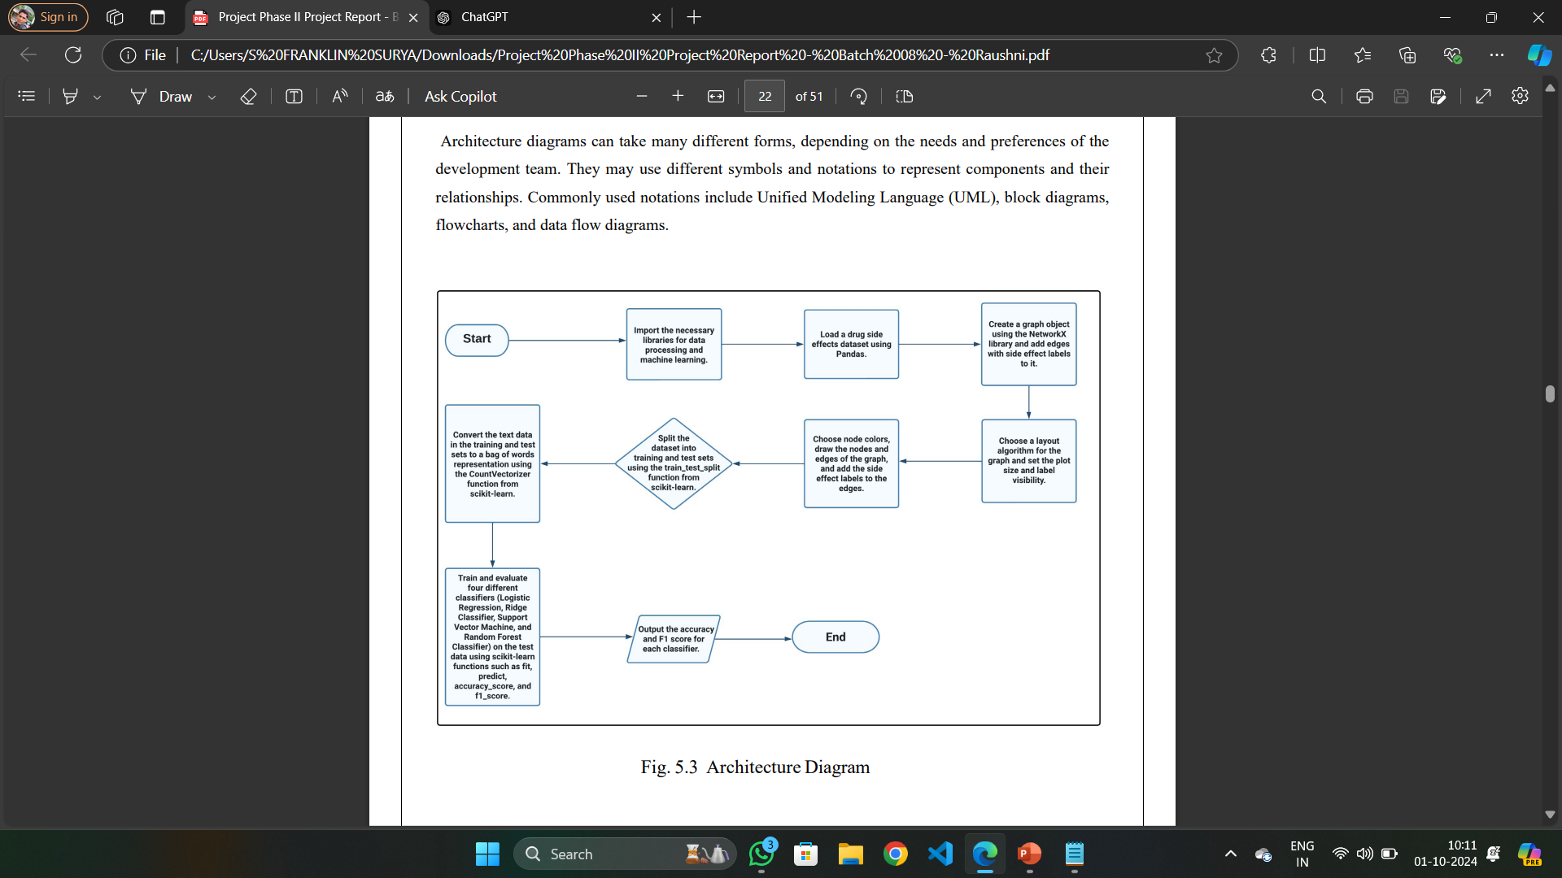
WORKFLOW DIAGRAM

Slide 9
DRAWBACKS OF EXISTING SYSTEM
Existing systems for implementing graph embedding to reduce multi-drug effects have several limitations. Scalability is a significant concern, as these systems struggle with large datasets, resulting in computationally expensive processes and prolonged processing times.
Many systems rely on incomplete or outdated datasets, compromising data quality and the accuracy of embeddings and predictions. The complex representations of graph embeddings also hinder interpretability, making it challenging to discern the relationship between embeddings and specific drug interactions.
Additionally, overfitting is a risk when training on limited data, leading to poor generalization for unseen interactions. Hyperparameter sensitivity requires extensive tuning, which is time-consuming and demands domain expertise. Integration with existing pharmacological databases can be challenging, and insufficient consideration of biological context may diminish prediction relevance.
Lastly, inadequate validation against real-world scenarios and the computational complexity of advanced techniques can render these systems inaccessible for smaller research groups or institutions with limited resources, affecting their overall reliability.

Slide 10
PROPOSED SYSTEM
This section outlines the proposed model for predicting drug-drug side effects, emphasizing the innovative approach of feature extraction from a graph representation of drug interactions.
The model iteratively processes all nodes and their neighbors within the graph, generating a list of binary features for each node that indicates its connections to neighboring nodes. This feature set captures the structural relationships in the graph, which are crucial for understanding potential side effects.
The model trains and evaluates a range of classifiers, including Logistic Regression, Ridge Classifier, Support Vector Machine, Random Forest Classifier, Perceptron, Passive Aggressive Classifier, and SGD Classifier. Each classifier's performance is assessed using various evaluation metrics such as accuracy, F1 score, precision, recall, and confusion matrix, providing a comprehensive analysis of their effectiveness.
By employing graph-based feature extraction and rigorous evaluation, the proposed system aims to enhance the accuracy and reliability of drug side effect predictions, facilitating better clinical decision-making.

Slide 11
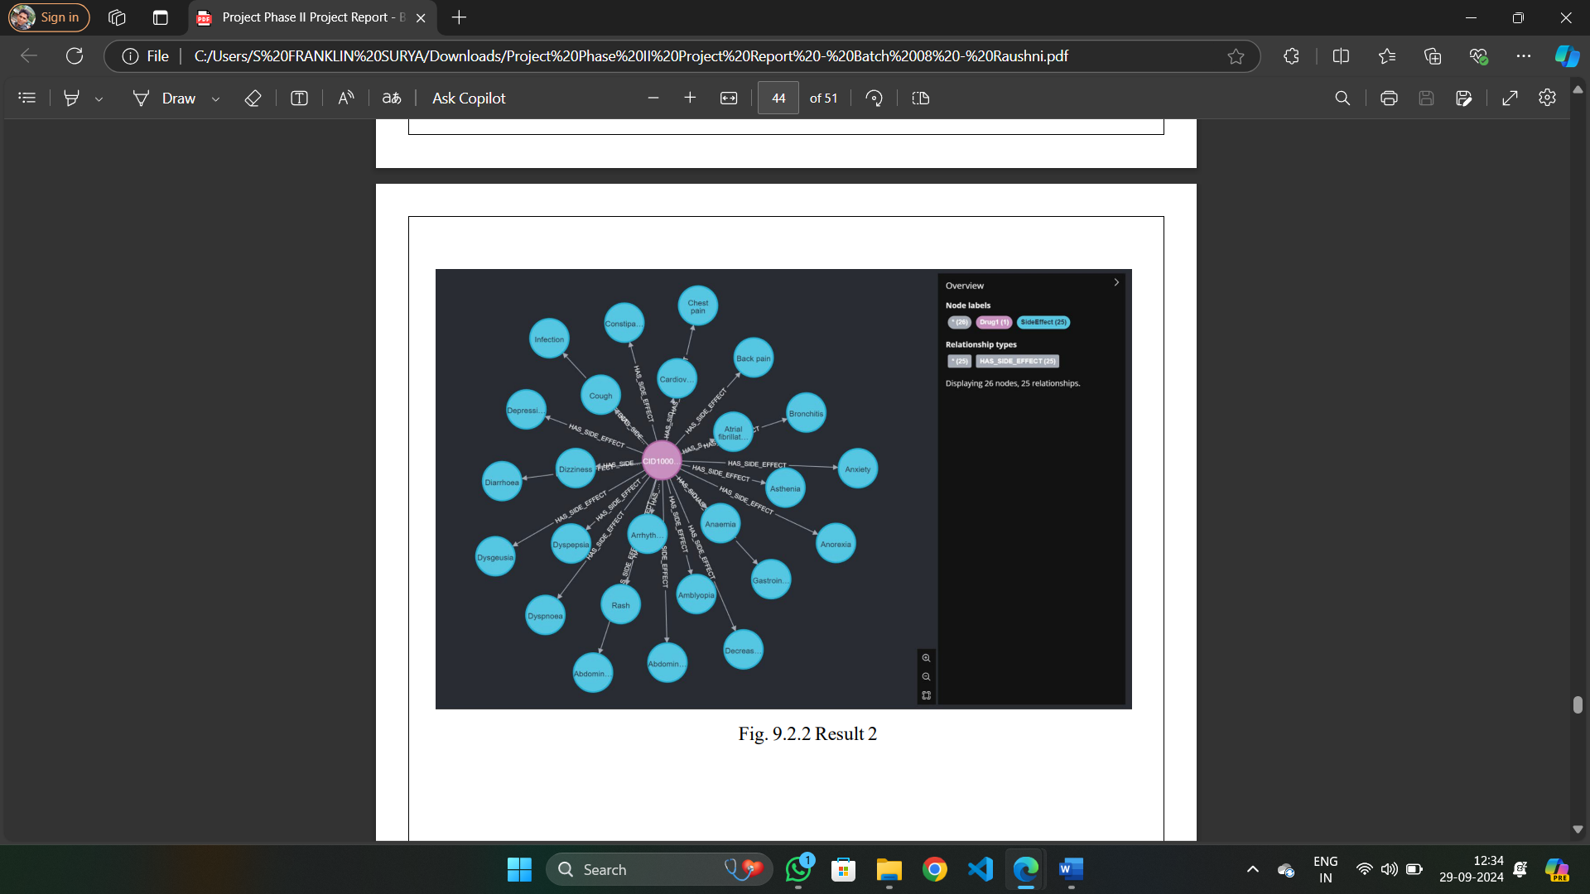
RESULT AND DISCUSSION
In this study, we developed a deep learning model for predicting drug-drug interactions using a dataset of 1164 drug pairs and their corresponding side effects. We trained on a random 80% of the data and tested on the remaining 20%. We also used a balanced accuracy metric to account for the class imbalance in the dataset. The results showed that our model achieved an overall balanced accuracy of 98% for predicting drug-drug interactions, with a F1_score of 97%. Here are the comparison tables for different classifiers. The following tables shows the31test results on different classifiers. Where test_size isthe percentage of data used for testing and random_state is the seed value used to split the graph.

Slide 12
CONCLUSION
Explore methods for improving the interpretability of the model, such as feature importance analysis or visualization techniques, to make it more useful for clinical decision-making.
Conduct a clinical trial to evaluate the model's performance in predicting drug-drug interactions in a patient population, in order to assess its real-world applicability and identify any limitations or challenges in implementing the model in practice.
Develop a user-friendly interface that allows for easy input of patient-specific information and provides clear output of predicted drug-drug interactions and associated risks. Expand the scope of the model to include other types of medication-related risks, such as drug disease interactions or adverse drug reactions, to provide a more comprehensive picture of potential medication risks for individual patients.
Recent advances in computational methods and machine learning have provided new opportunities for predicting drug-drug interactions and side effects. However, existing methods still have limitations, including poor performance, limited generalizability, approaches to predicting drug-drug interactions and side effects that can improve the accuracy and efficiency of current methods.

Slide 13
REFERENCES
Atanasov AG, Supuran CT, Zotchev SB, Dirsch VM. “Natural products in drug discovery: advances and opportunities. Nat Rev Drug Discovery”. 2020;20(3):200–16.
Yue X, Wang Z, Huang J, Parthasarathy S, Moosavinasab S. Graph Embedding on biomedical networks: methods, applications, and evaluations. Bioinformatics. 2020;36(4):1241–51.
Dong Y, Chawla N, Swami A. Metapath2vec: scalable representation learning for heterogeneous networks. In: Proceedings of the 23rd ACM SIGKDD international conference on knowledge discovery and data mining; 2017. p. 135–144.
Xu L, Wei X, Cao J, Yu Philip S. Embedding of embedding (EOE): joint embedding for coupled heterogeneous networks. In: Proceedings of the tenth ACM international conference on web search and data mining. 2017. p. 741–749.
Qian X, Xiong Y, Dai H, Kumari KM, Wei DQ. PDC-SGB: prediction of effective drug combinations using a stochastic gradient boosting algorithm. J Theor Biol. 2017; 417:1–7. [6] M. Khonji, Y. Iraqi, and A. Jones, “Phishing detection: A literature survey,” IEEE Community. Surv. Tutorials, vol. 15, no. 4, pp. 2091–2121, 2013.

